Slide 1







Home Page
About Us
Login
Manager/Agent
Customer
Manager menu
Agent menu
New Customer
Existing Customer
Recommended package
Search package
Statistics
Add agent
View DB
Add package
Customers’ orders
Answer customer
Package DB
Sign up
Customer menu
Contact Us
My Account
Reservation
Add package
Remove package
Personal Details
Order history
If visitors want to book they must sign in/sign up

Slide 2








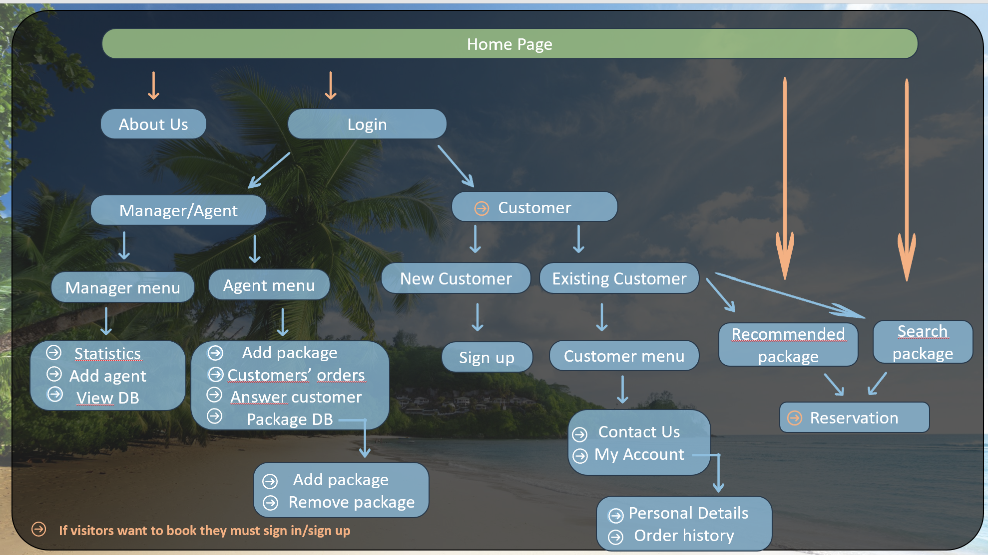

Home page
About us
Home page
Login
Search Package
Paris 2 nights in “King David" 200$
London 3 nights in "Hilton" 320$
Tokyo 5 nights in "Sheraton" 400$

Slide 3
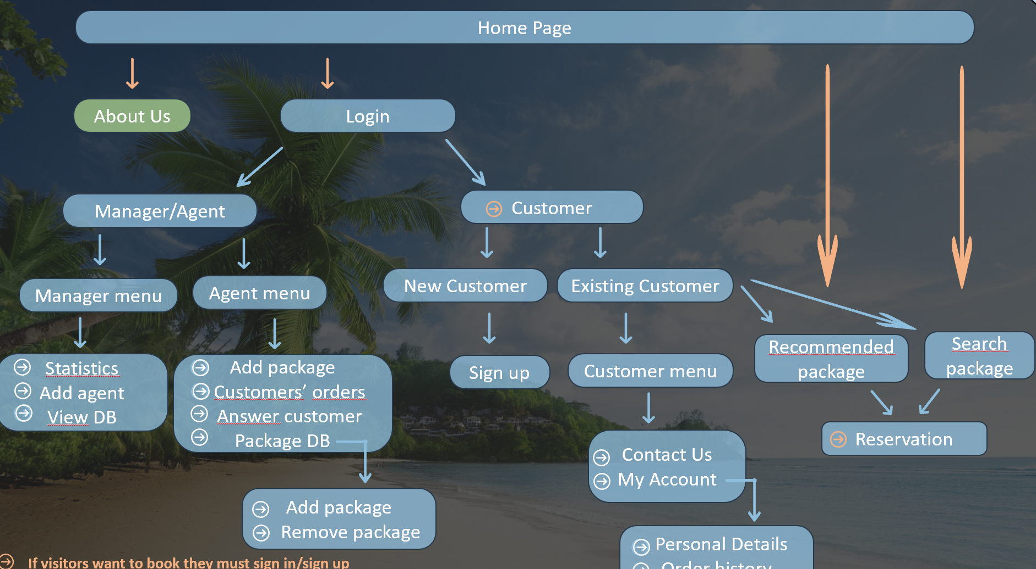
About Us
About us
Date of foundation : …
About the company : …
Advantages : …
Terms of Use

Slide 4
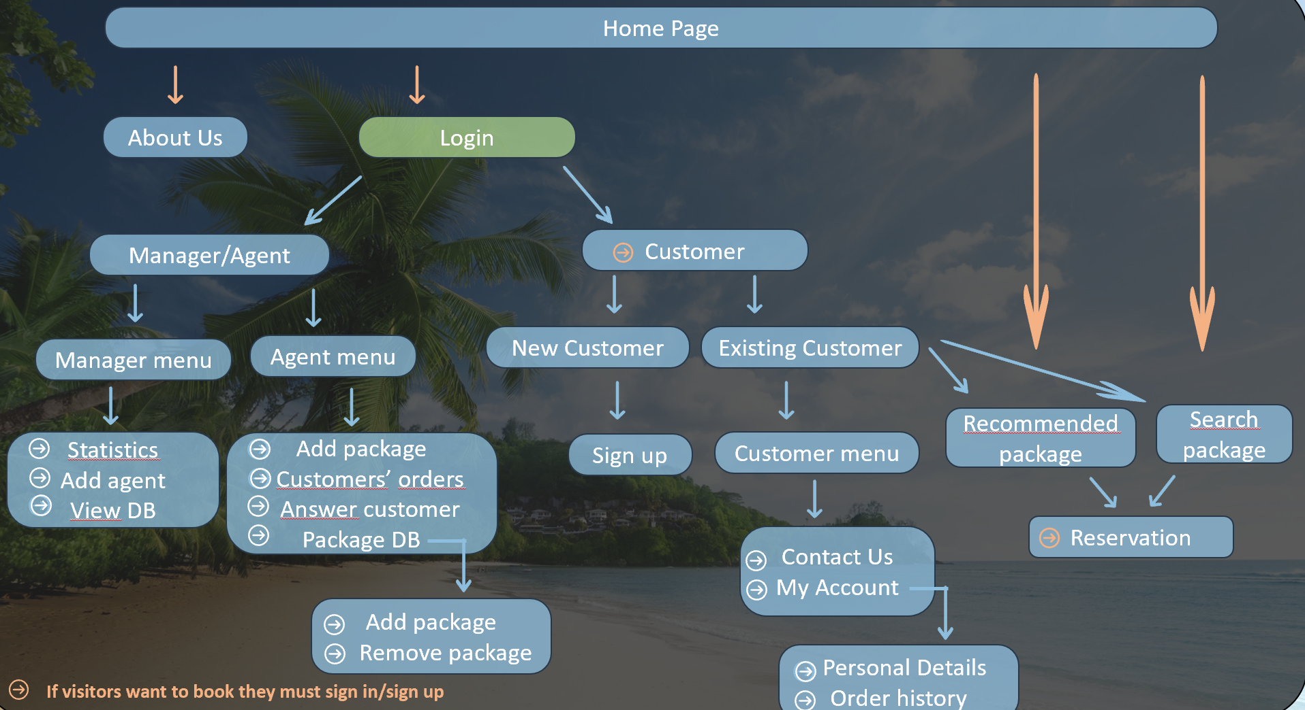

Login
Login
Manager/Agent
Customer

Slide 5
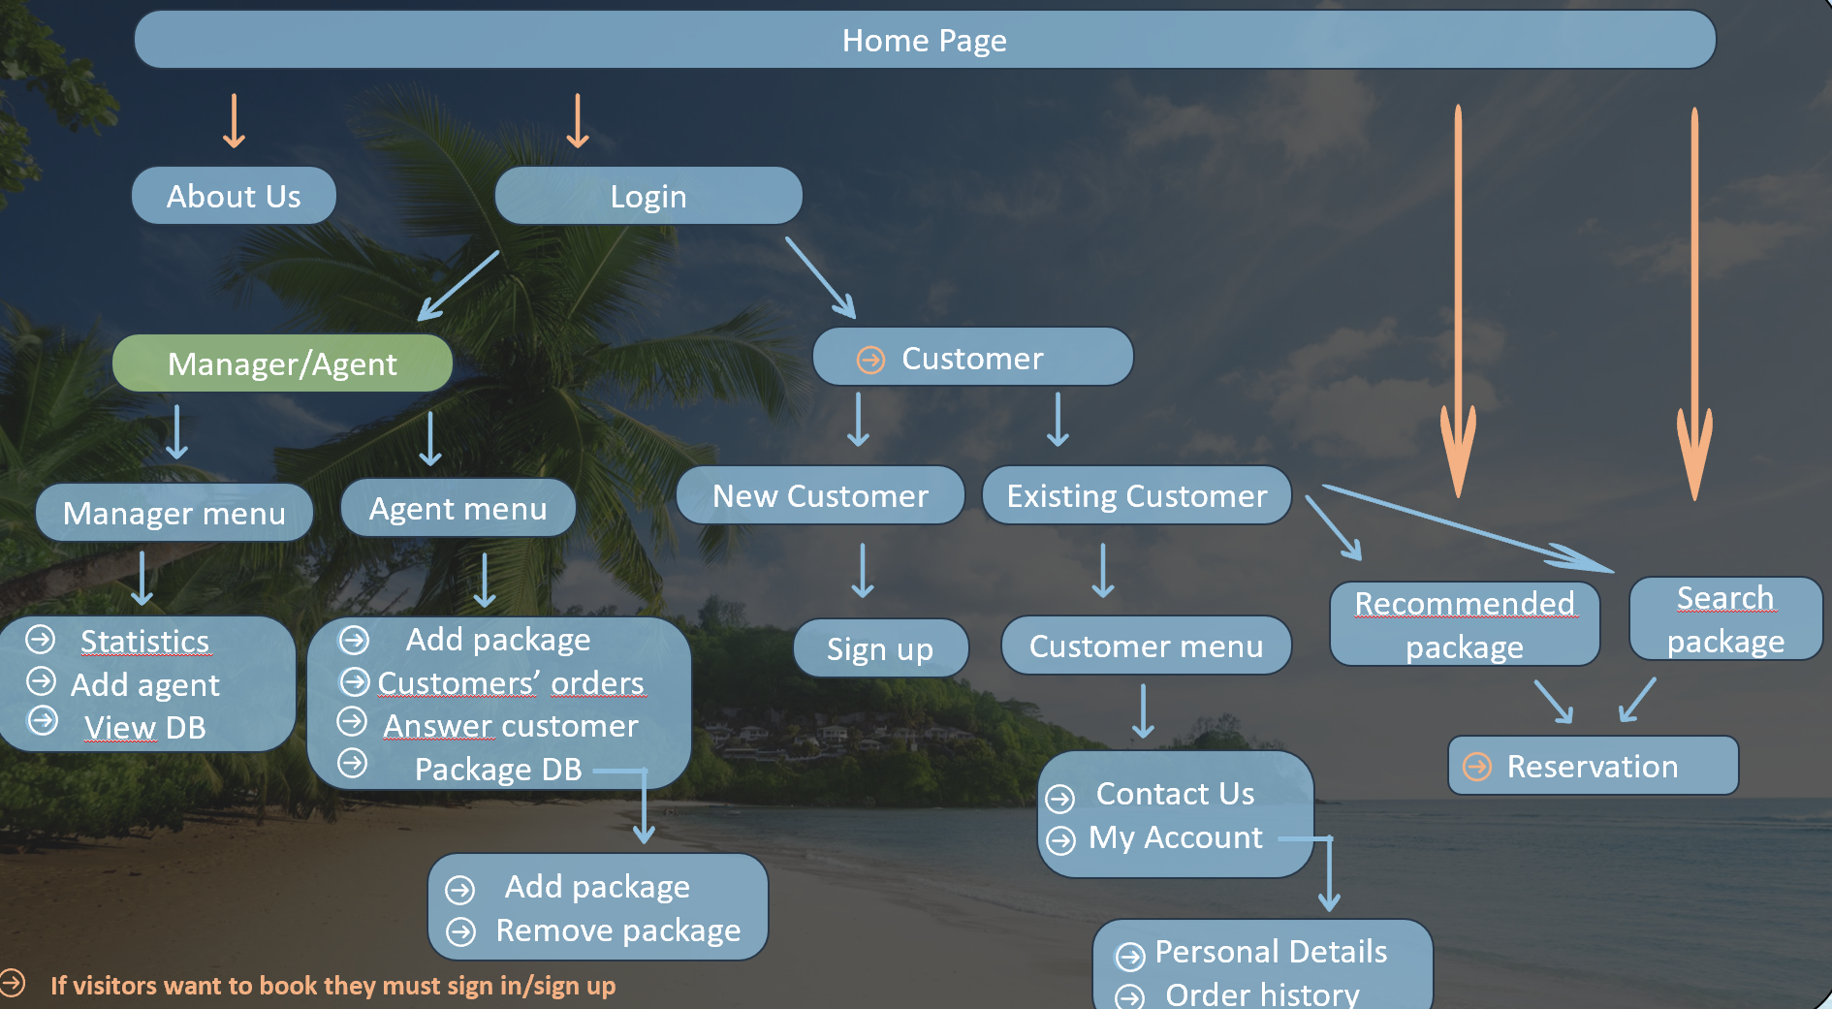
Manager/Agent
Manager/Agent
ID :
Company Password :

Slide 6
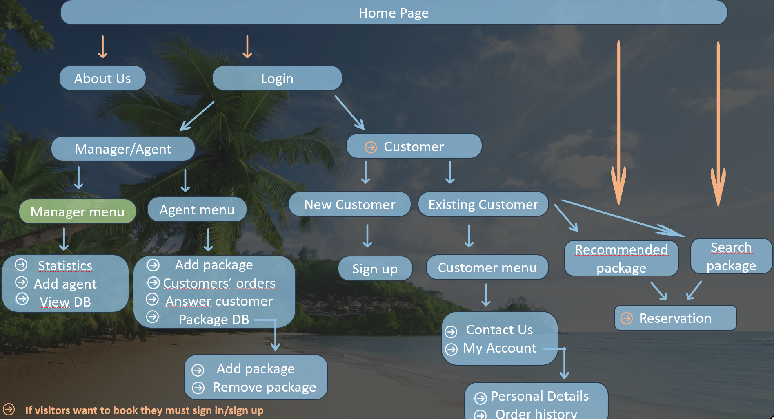
Manager Menu
Manager Menu
Add Agent
Statistics
View DB

Slide 7
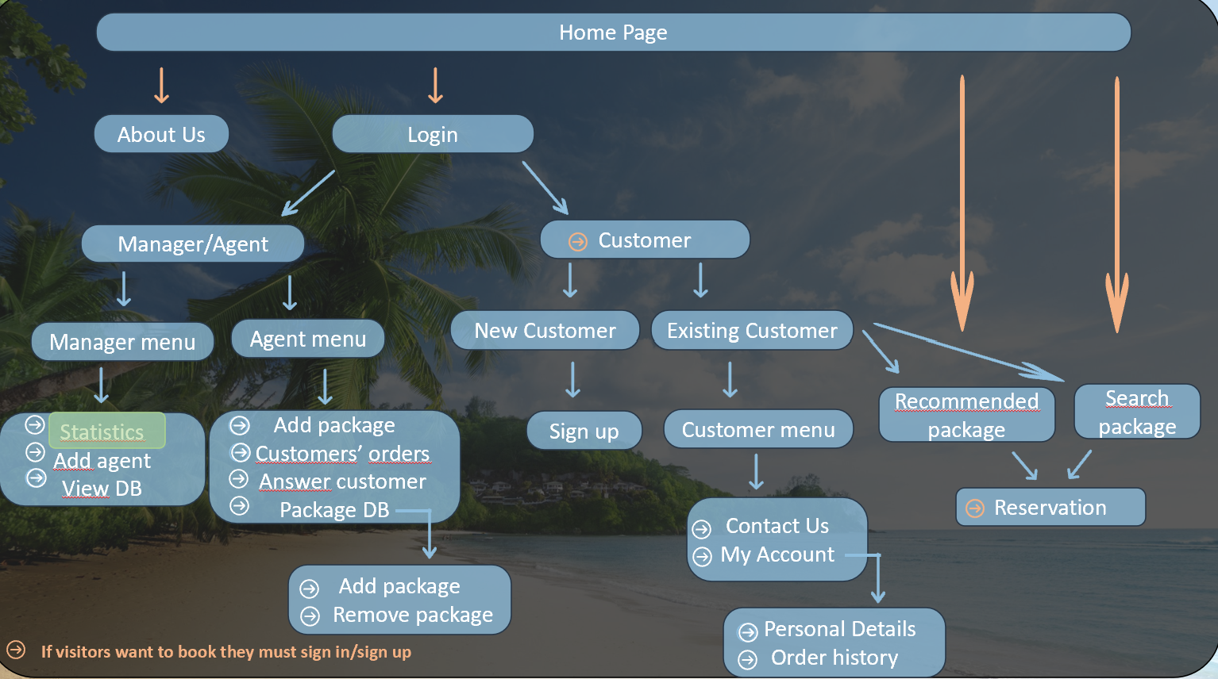
Statistics
Statistics
Report
Packages Sales
Tracking Agent Sales

Slide 8

View DB
View DB
First Name | Last Name | ID | Area | Package sale
Yohann | Mizan | 12345678 | Europe | 3
Salome | Koskas | 12456677 | Asia | 6

Slide 9
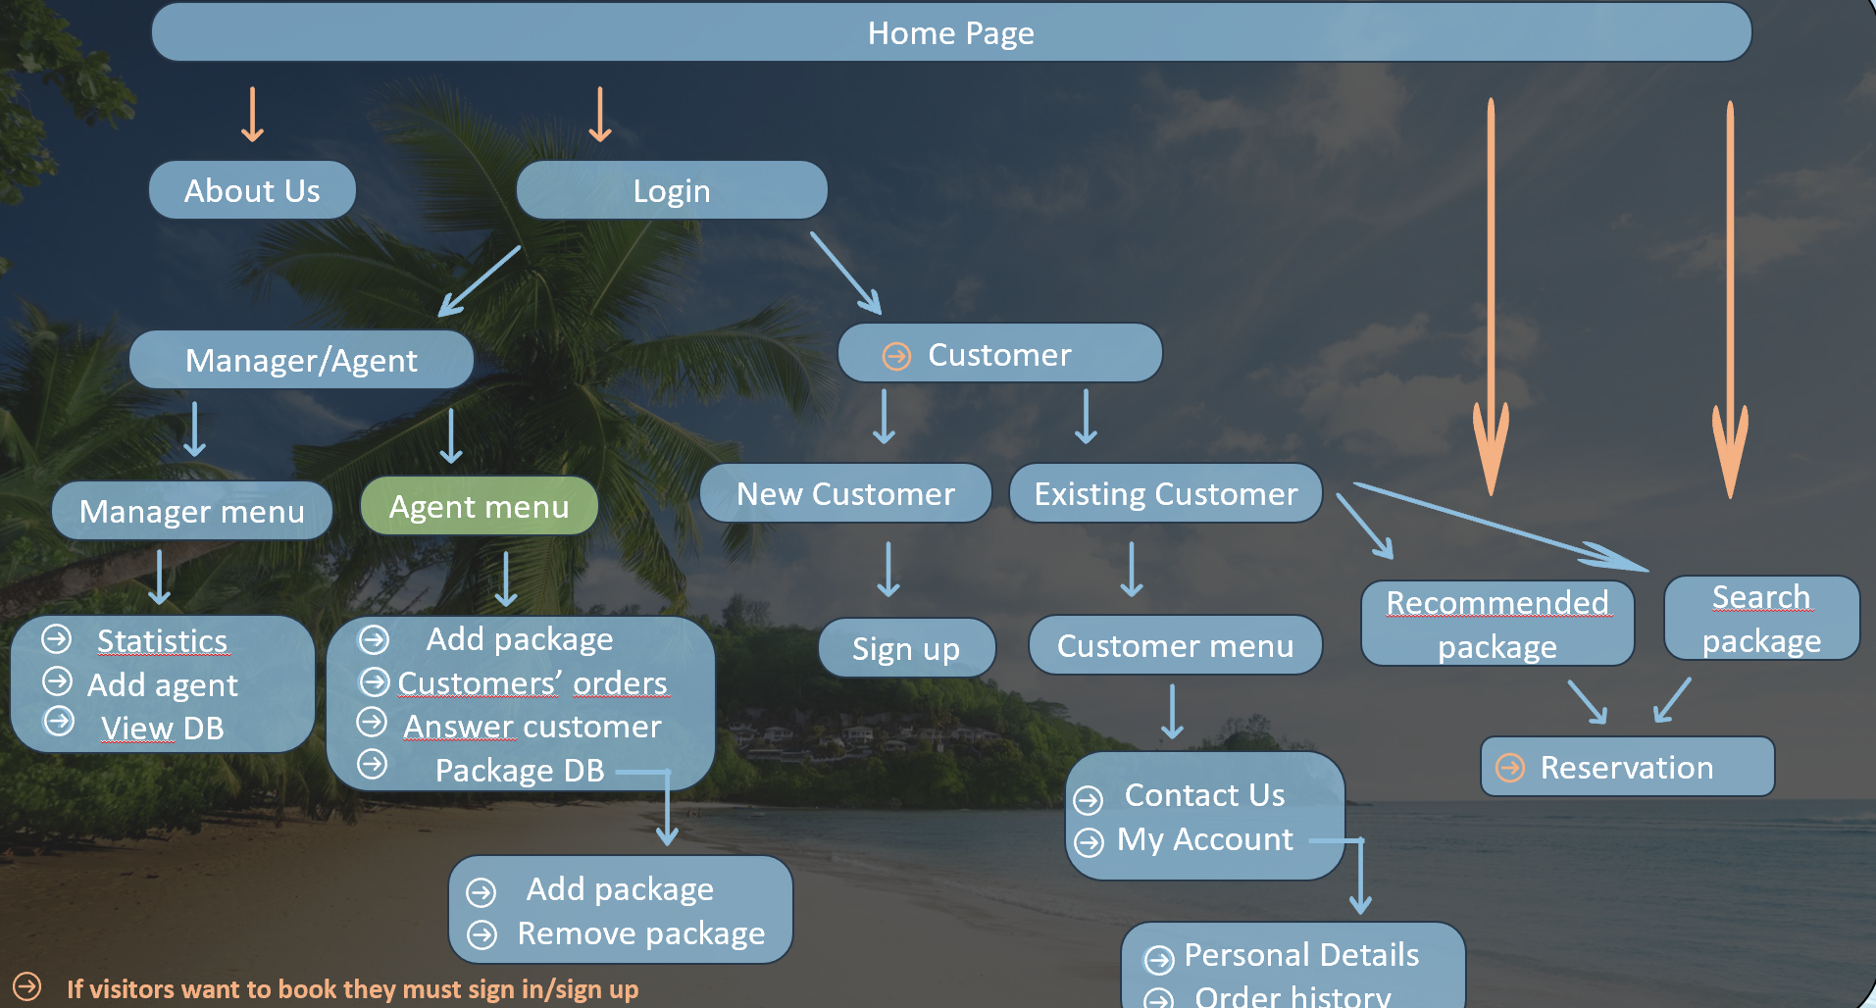
Agent Menu
Agent Menu
Add Package
Customers’ orders
Answer Customer
Package DB

Slide 10


Customers’ Orders
Customers’ Orders
First Name | Last Name | Package ID | Status
Yohann | Mizan | 345667 | Approved
Salome | Koskas | 575469 | In Process
Approved
In Process
Cancelled
Save changes

Slide 11
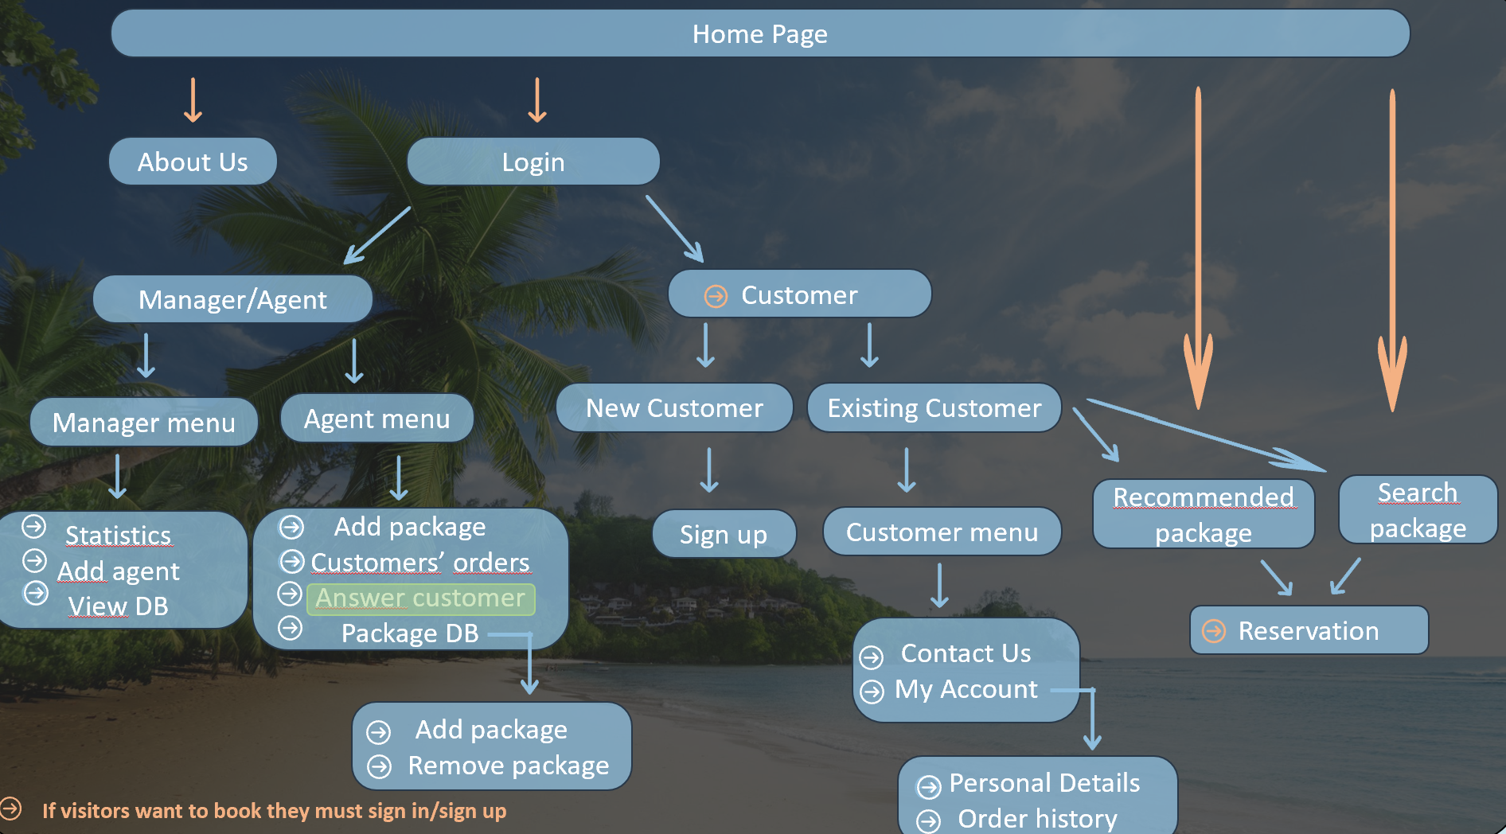
Answer Customer
Answer Customer
First Name | Last Name | Phone | Message | eMail
Yohann | Mizan | 054125372 | Need Info… | yohanm@..
Salome | Koskas | 053172991 | Need Info… | salomek@..

Slide 12
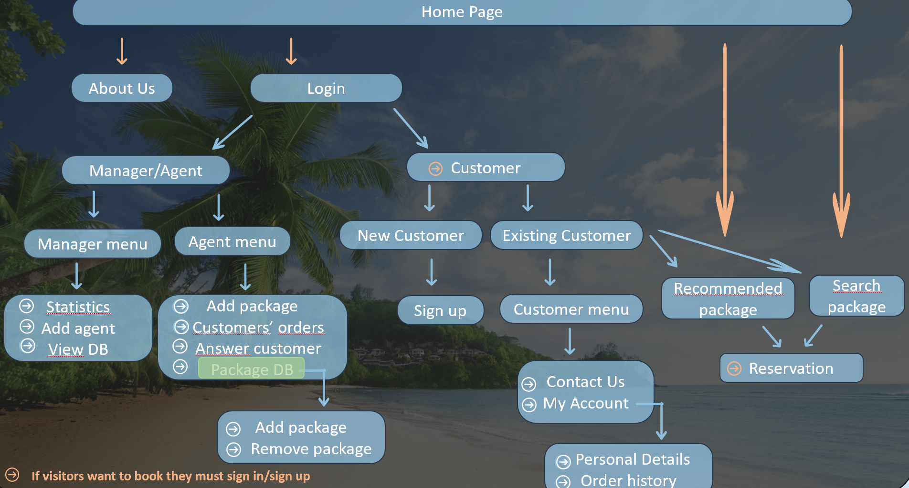
Package DB
Package DB
Package ID | Date | Destination | Price | Quantity
345667 | 01/02/20 | Paris | 2599 | 10
575469 | 04/12/21 | Tokyo | 1599 | 20
Add Package
Remove Package
Update Package
Save changes

Slide 13
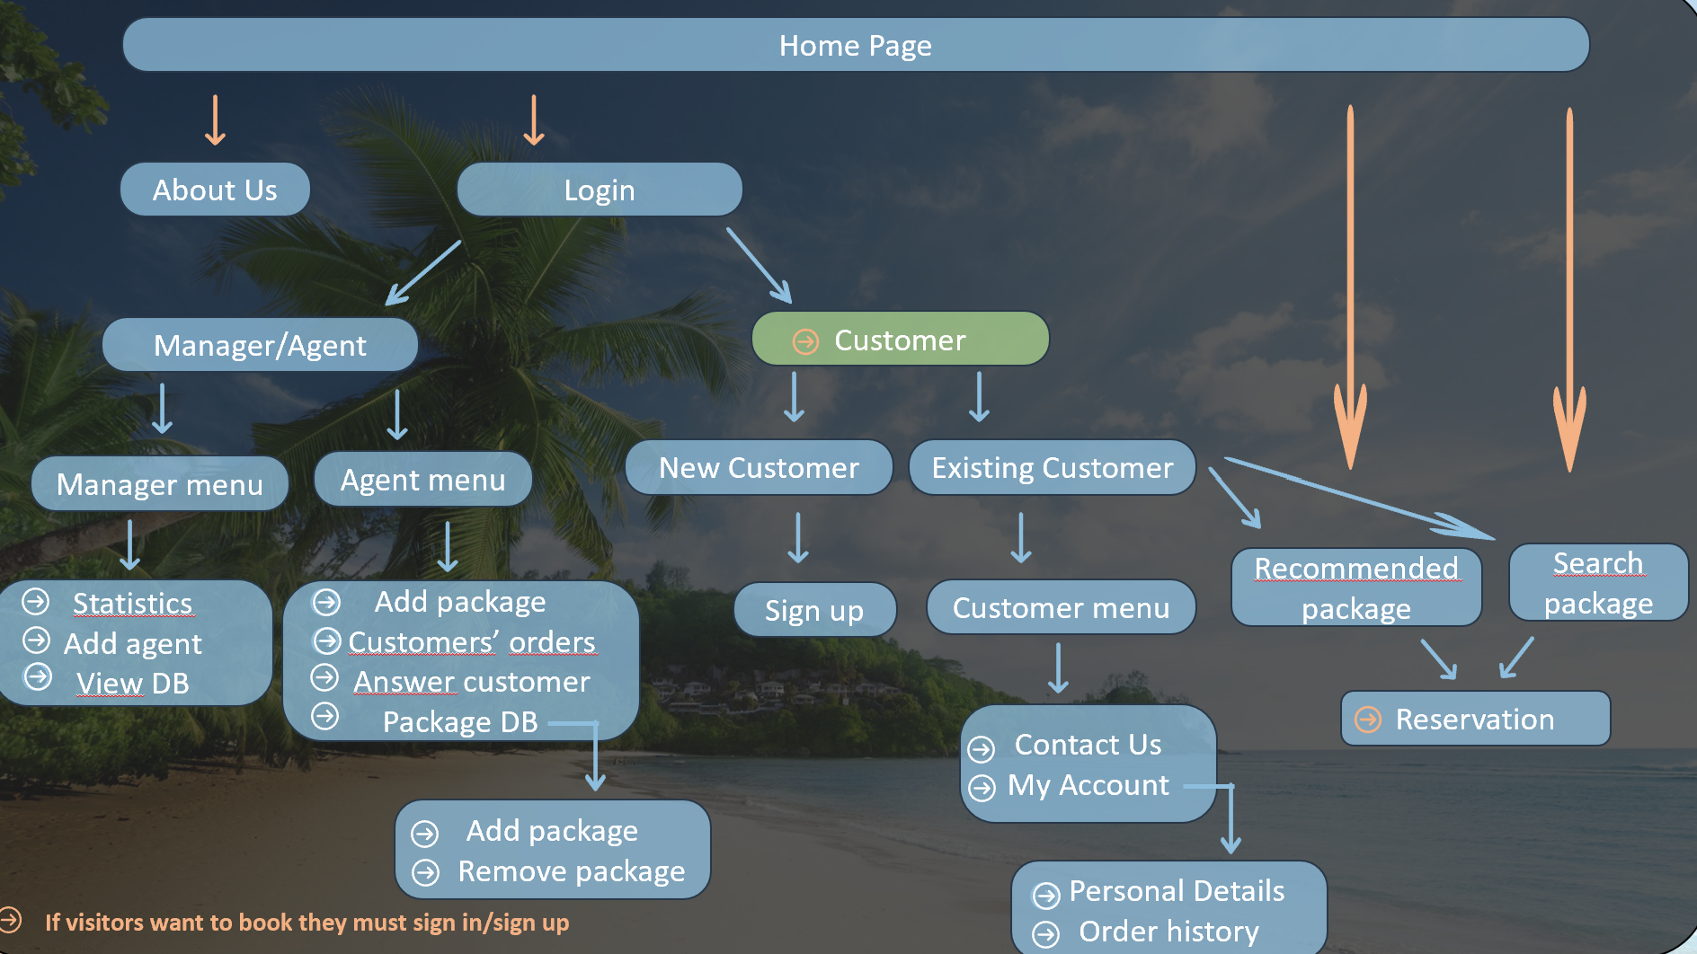
Customer
Customer
New Customer
Existing Customer

Slide 14
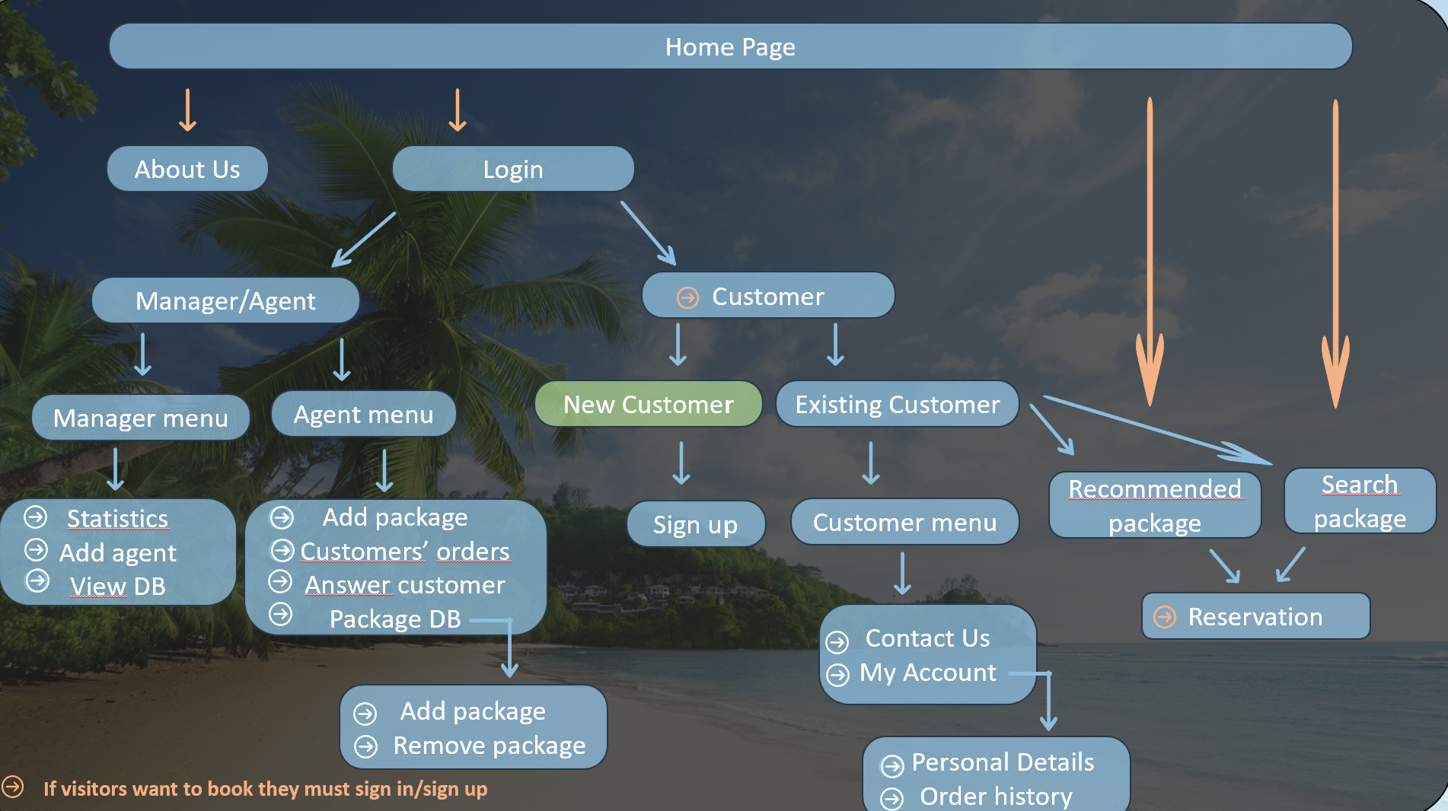
New customer
/sign up
New customer
First Name :
Last Name :
ID :
Email :
Phone Number :
Password :
Confirm Password :
Sign Up

Slide 15

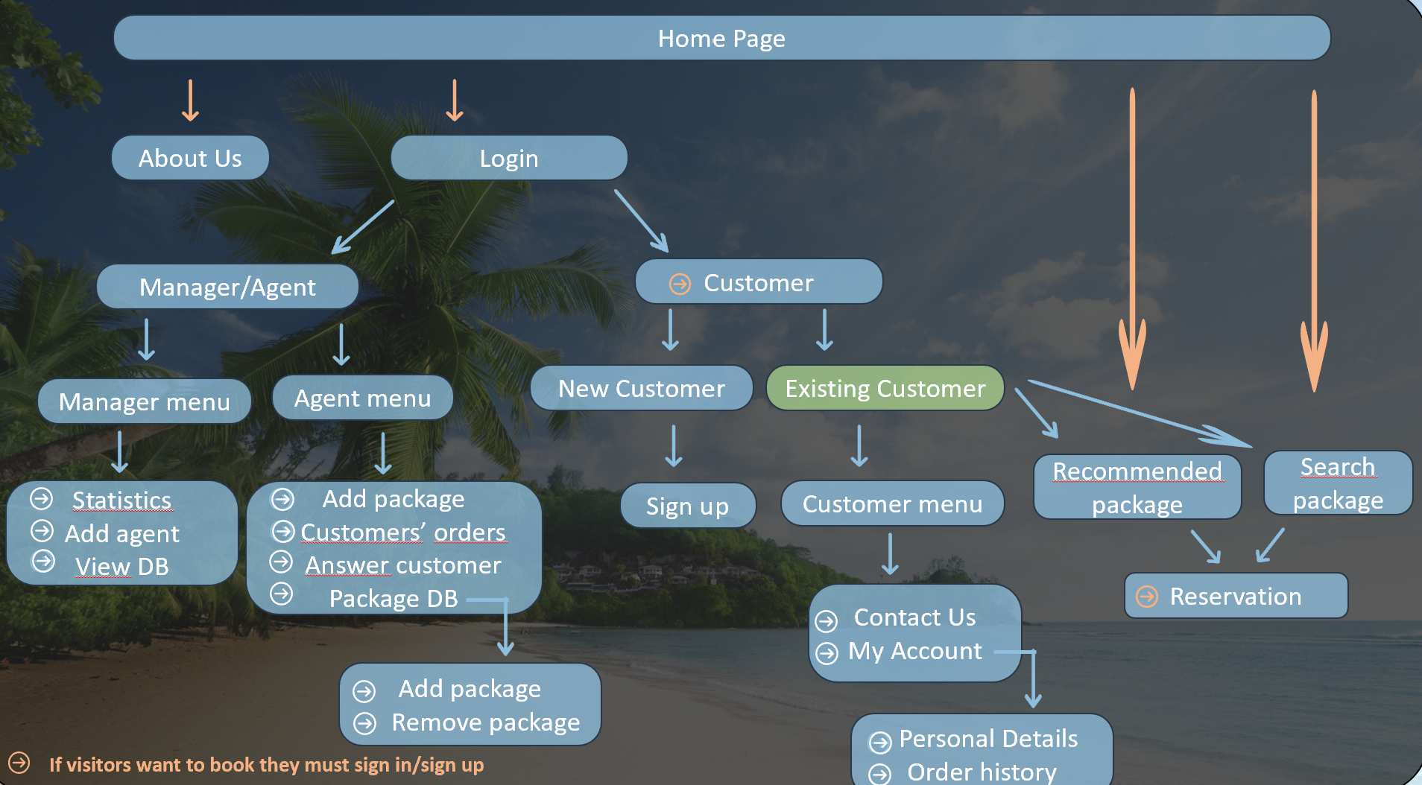
Existing Customer/Sign in
Existing Customer
ID :
Password :
Sign In
Forgot Password ?

Slide 16
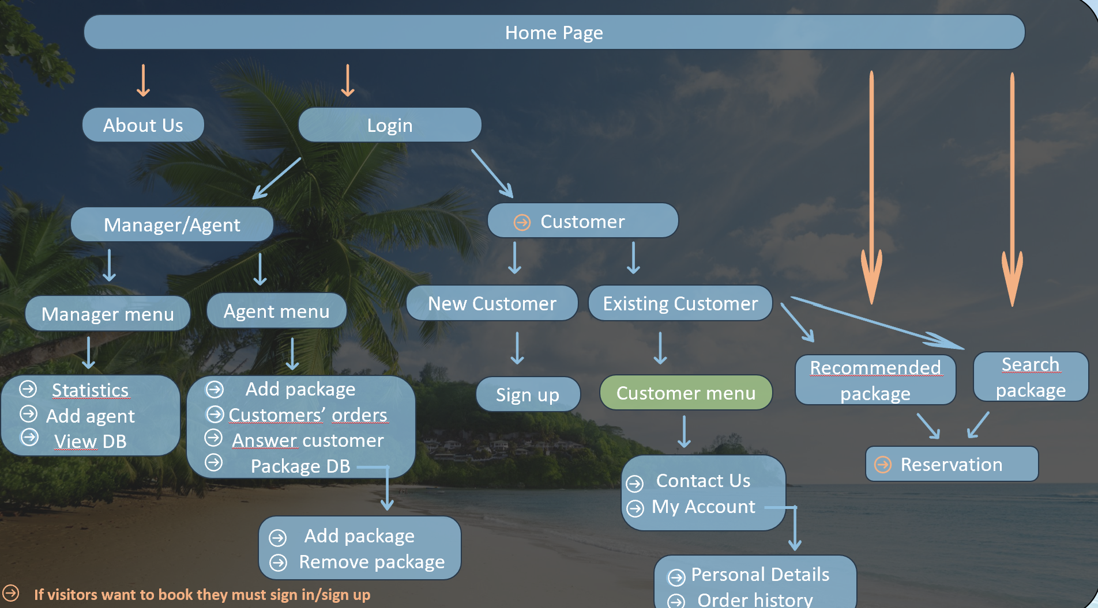
Customer Menu
Customer Menu
Contact Us
My Account

Slide 17


Contact Us
Contact Us
Leave message : …
Send
Destination

Slide 18
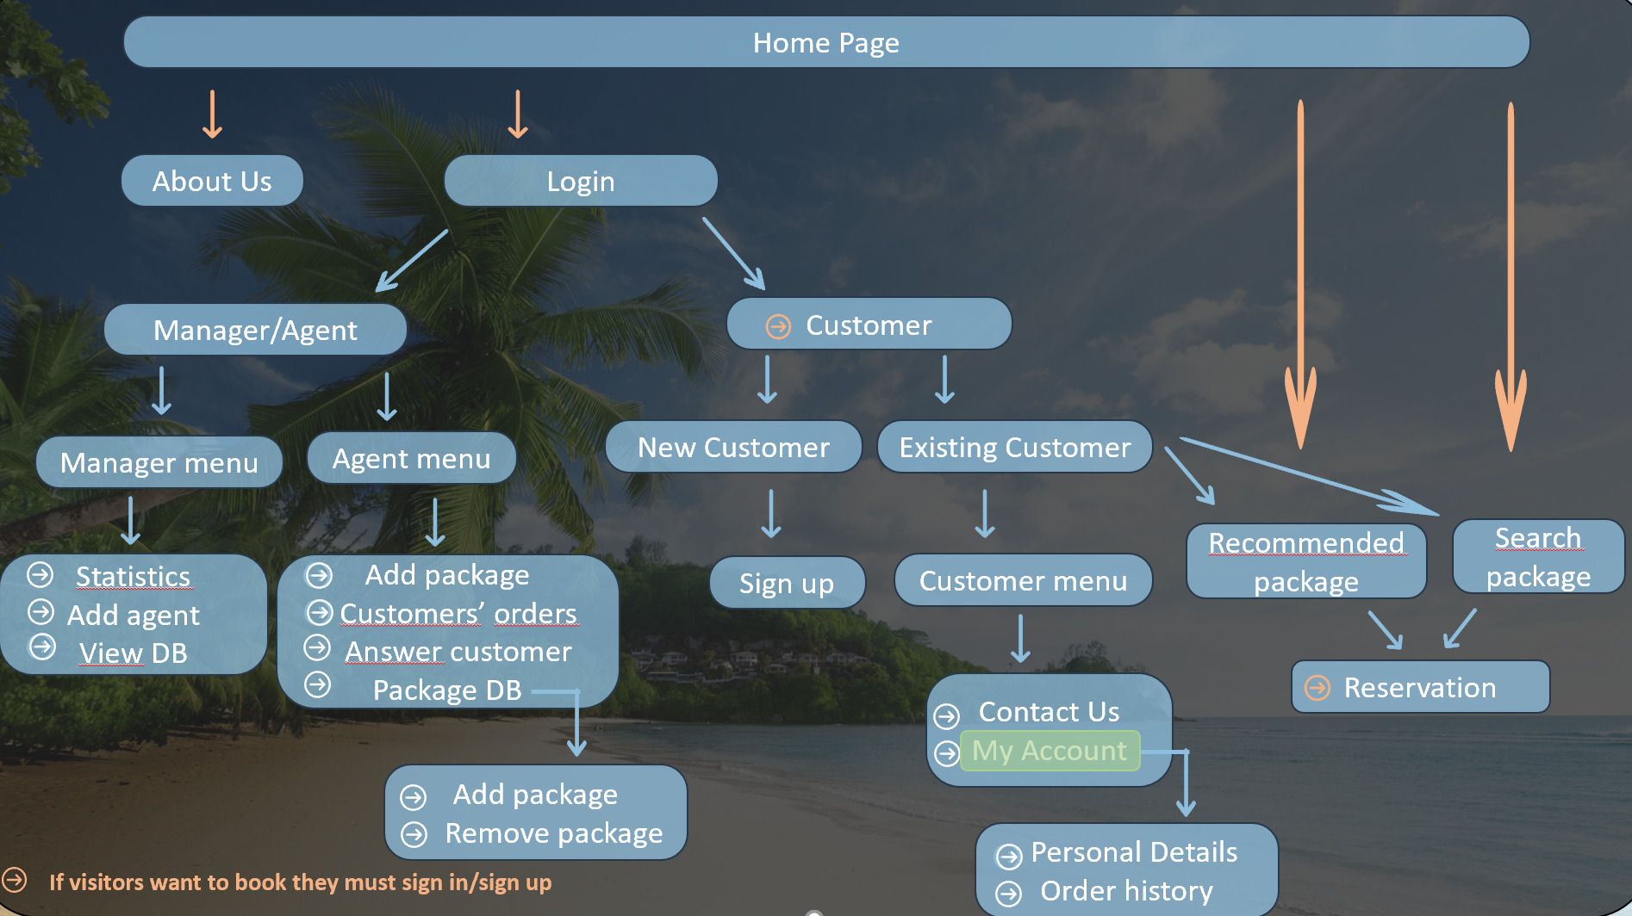
My Account
My Account
Personal Details
Order History

Slide 19
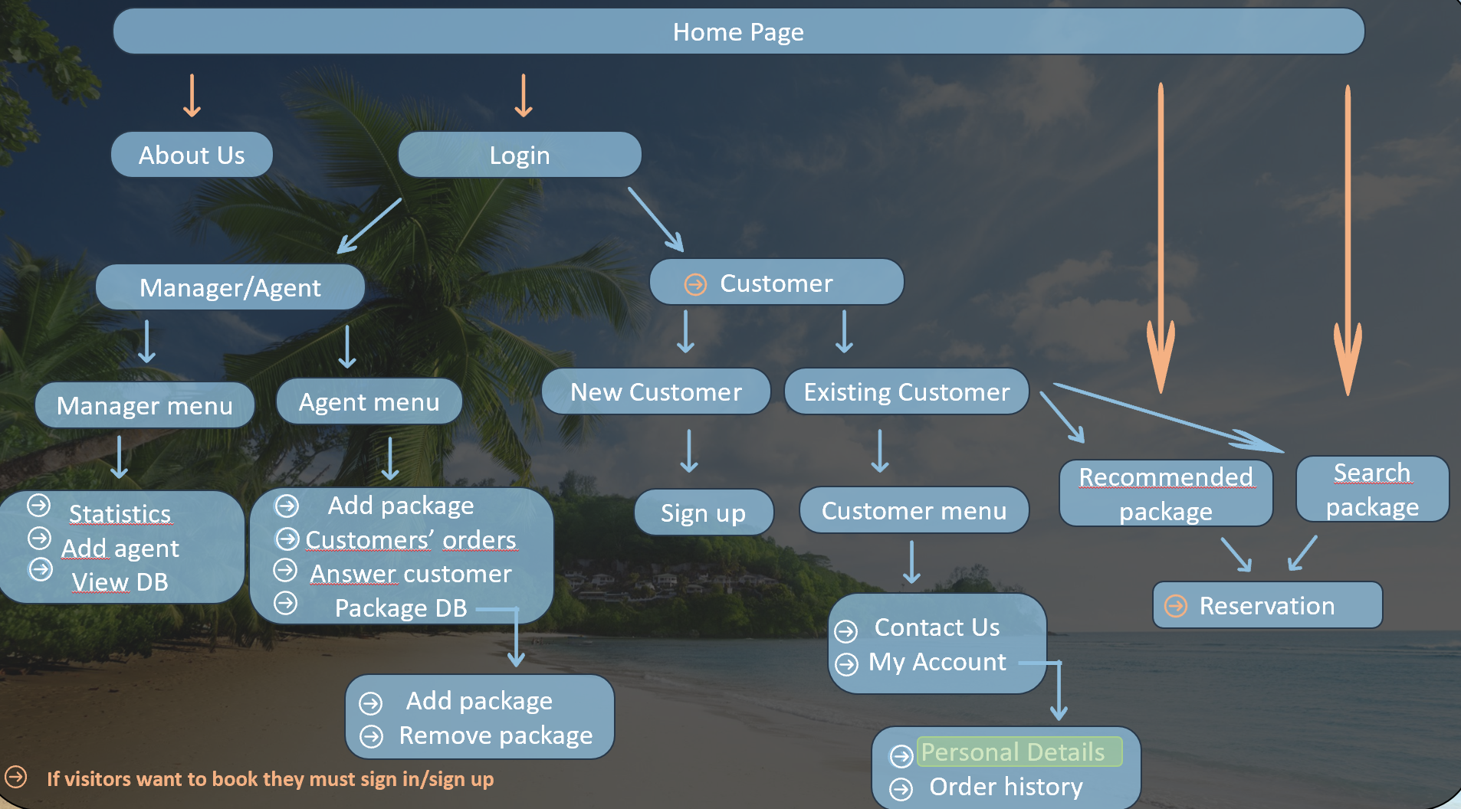
Personal Details
Personal Details
First Name :
Last Name :
ID :
Email :
Phone Number :
Password :
Yohann
Mizan
632739
Yohanm@...
054123456
yohannmizan
Delete Account
Change Information

Slide 20
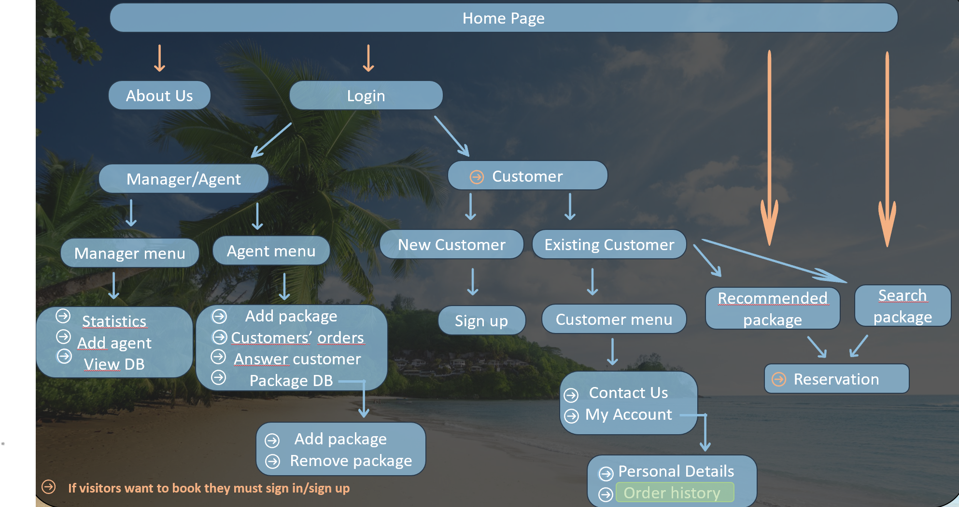
Order History
Order History
Destination | Date | Package ID | Status
Paris | 01/02/20 | 345667 | Approved
Tokyo | 14/12/21 | 575469 | In Process
Accumulated points:
10

Slide 21




Recommended Package
Recommended Package
London 3 nights in "Hilton" only 320$
Paris 2 nights in “King David" hotel only 200$
Tokyo 5 nights in "Sheraton" only 400$
Paris
Tokyo

Slide 22
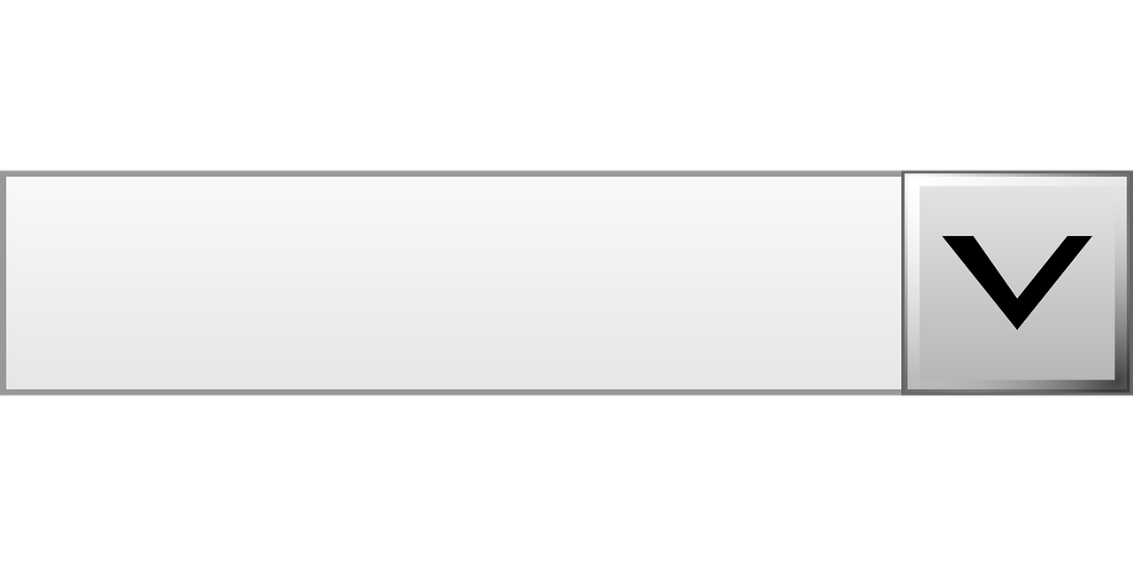
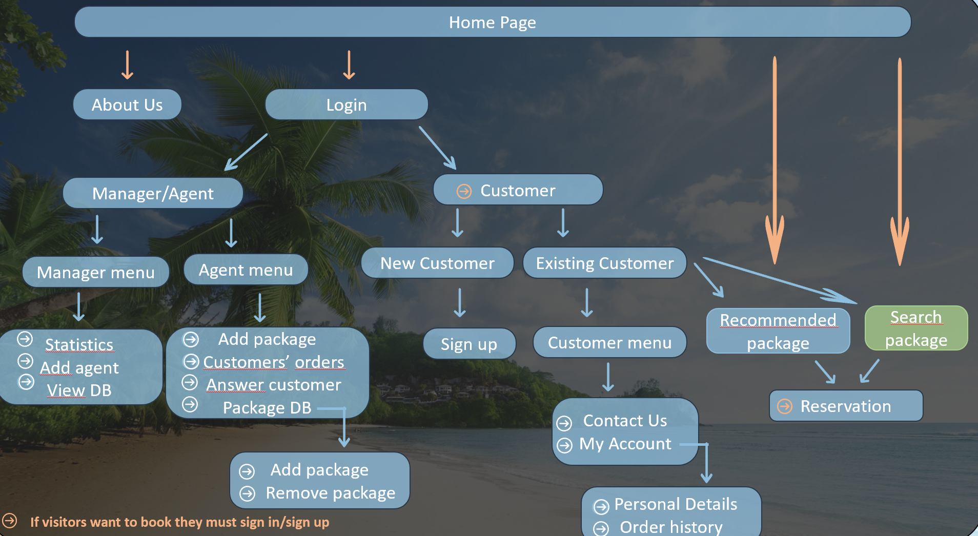
Search Package
Search Package
Type
Destination
Price
Vacation
Flight
Hotel
Range of Date
Number of people
Organisation trip for groups
Friend for vacation

Slide 23



Reservation
Reservation
Package ID | Date | Destination | Price | Quantity
345667 | 01/02/20 | Paris | 2599 | 1
Transportation + 50$ : Yes No
Total Price : 2649$

